Slide 1
POLICY
TERMINATOR
BOT
AN ACTIVE K8S COMPLIANCE ENFORCING BOT
BY REWANTH TAMMANA

Slide 2
ABOUT ME 🧑
Security Ninja & Open-source contributor
Passionate about DevSecOps, Container, Cloud-native & Application security
Active open-source contributor. Added 17,000+ LOC to Nmap during GSOC
Created multiple krew plugins to extend kubectl/K8S functionality
Holds all K8S certifications (CKS, CKA, CKAD) - Maybe because I got sponsored 😜
Speaker & Trainer at multiple international security conferences - DEFCON,HITB,etc
NOTE: Delivered 4 day training on Kubernetes security at BlackHat USA
MVP researcher on Bugcrowd (2018) for identifying most number of vulnerabilities
Crew member & CTF challenges creator at security conferences like Nullcon, etc
Moderator at conferences like All Day DevOps,etc & part of AWS community builder
Creator of Damn Vulnerable Bank. An intentionally vulnerable Android app
Published an IEEE research paper on an offensive attack in ML & Security
Before all this, I started as a developer

Slide 3
ABOUT ME (Office POV) 🧑
Senior Security Architect @ Emirates NBD (National Bank of Dubai)
Responsible for on-prem cloud-native infrastructure security & DevSecOps
Leading the flagship transformation project of Openshift to Vanilla Kubernetes migration from security POV. Enabling GitOps approach, enhancing defense-in-depth controls, centralized monitoring, RBAC matrix, etc.
Building continuous security for K8S with service mesh, digital image signing, admission controllers, OPA Gatekeeper, Network Policies, etc.
Closely working with SOC team to enforce proactive monitoring for K8S
Enticing teams to adapt shift-left approach. Integrated SAST, SCA, IAST, etc.
Responsible for architecture design reviews & threat modeling
Mentored & coached passionate DevOps & developers towards security
GEM Award winner: Twice. Recognized for exceptional work & contributions
Built several in-house products to bridge the gap b/w security & other teams

Slide 4
TASK - Introduction 🤩
Help the customer implement a security control. The customer is using Kyverno to write admission control policies, but their security team wants to enforce policies for running Pods as well, and kill them if they contain policy violations. Your task is to implement a policy-terminator which will eliminate any Kubernetes Deployment containing non-compliant Pods.
The solution should remove running workloads which fail against a customer-supplied policy.
You can assume all policies will be applied cluster-wide.
Your solution should separate policies from code, i.e. the customer should be able to add or change policies without rebuilding or re-deploying your solution.
The customer would prefer not to learn a new policy syntax. You may use any programming language or technology you choose to solve this task. However, we like Go operators, and recommend using one here to reconcile Kyverno’s ClusterPolicyReport resources.
As a demonstration policy, we suggest requiring all Pods to have the owner: label set.

Slide 5
TASK - Interpretation 📖✍️
Customer requirements:
Apply a tooling to perform compliance checks of entire cluster
The tool should be able to list all the violated resources information
Policies can be applied cluster-wide
Customer should be able to edit policies easily without the need to learn complex computer languages
Any programming language can be used to solve this task
For the demo purposes, we can use a require-label policy
Build a solution/product that should continuously monitor the cluster for the violations
Once the violations are identified, terminate them

Slide 6
TASK - Assumptions 🙄😮‍💨
Customer requirements:
Why should we terminate “all” the violated resources? Is that even an ideal solution? For the case study, let’s say we should. But still that’s not a good deal, we need to find a way to minimize the blast radius/limit findings
Which tool should we deploy to enforce policies in the cluster? - Gatekeeper/Kyverno
Is it okay to apply policies cluster wide & terminate resources? - What about kube-system namespaces, etc
How to retrieve the violations of the resources? Do we get enough information from it?
Irrespective of Kyverno/Gatekeeper, the customer has to edit the files to update data & re-apply the policies. But that might be cumbersome for our customer. The best way would be for him to see something in regular english language. Let’s think about it later.

Slide 7
TASK - Assumptions (Cont…) 🤒🤕
Why should I use programming language to solve this task? I can write a simple bash script to execute kubectl commands, grep the output with jq, sed, awk, etc & fetch the list of violated resources. I can even terminate them, if I want to.
Let’s a resource got violated & our code terminated it. How will the developer/devops/business team know something got terminated? There should be a way to notify them. If we are notifying, why can’t we take a permission from them before terminating? Or maybe take a backup of the resource definition before deletion?
Multiple defense-in-depth controls can be enforced but for the task we will just focus on creating something that will ensure continuous compliance for the systems

Slide 8

DEMO TIME 😰

Slide 9
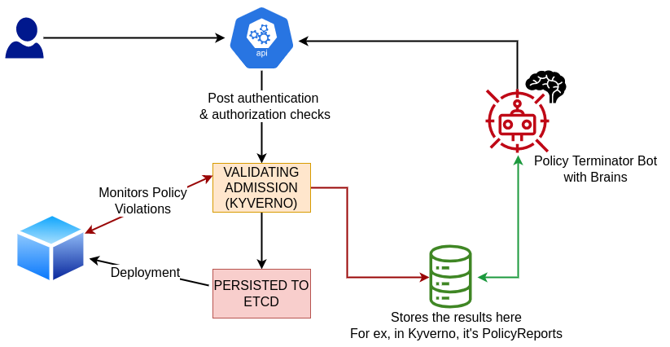
DESIGN WORKFLOW 🧐

Slide 10
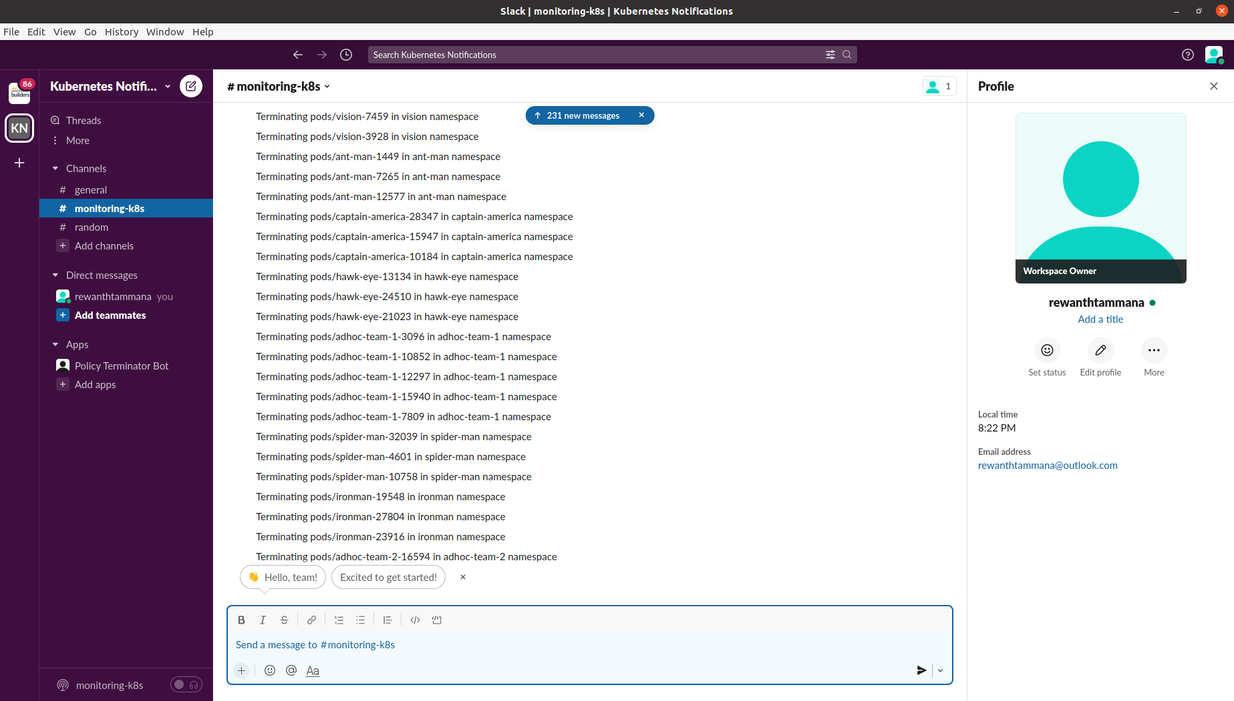
NOTIFICATIONS TIME 😫

Slide 11
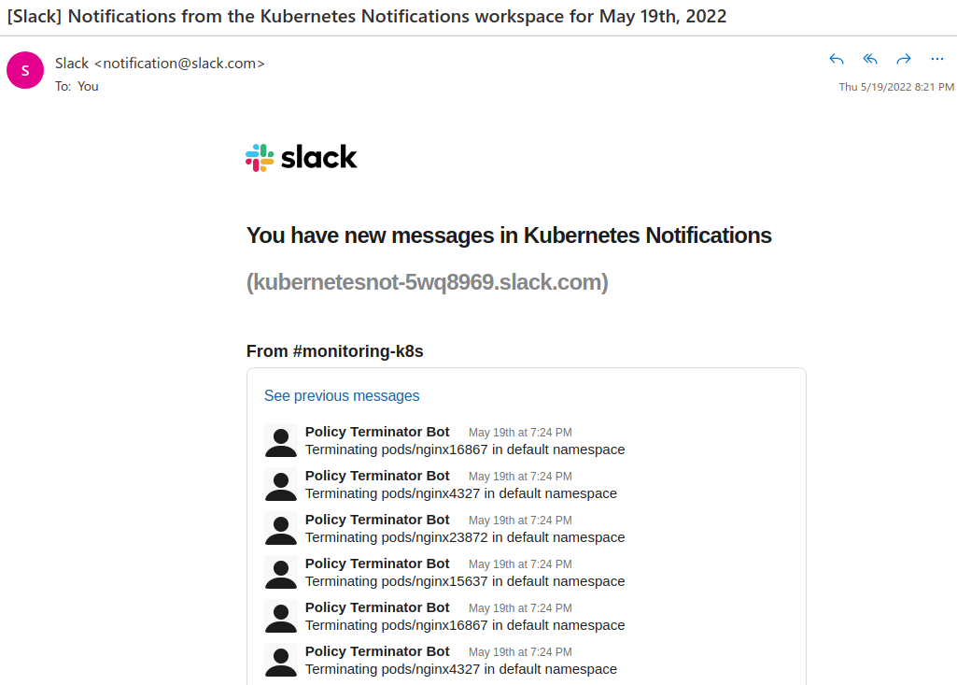
MAIL TIME 📨😫🥴

Slide 12
FUTURE ENHANCEMENTS 🧠
Instead of notifying users after termination, we can try sending interactive messages. Pod X violating rule Y. Do you want to terminate - Yes/No/Fix.
The Fix feature will have a pre-loaded set of configuration for each policy.
We can wait for 24/48 hrs & then apply a default the setting like Yes/No
Security risk involved with this feature. Chances of data tampering.
As of now, the deletion is happening only for pods & deployments.
This can be extended to daemonsets, replicasets, statefulsets, etc.
Create a custom RBAC role & rolebinding for policy-terminator-bot
Dockerize the application
Multiple duplicate entries in the slack notifications should be fixed.
Even if the pod is in “Terminating” state, the policy-terminator-bot will consider it as a violation & it triggers the delete resource function.

Slide 13
FUTURE ENHANCEMENTS(Cont…)🧠
Add more test cases to the product
Add a flag to ignore slack notifications
Add extended support to emails/discord/MS teams,etc
Add descriptive messages in the slack notifications like violated policy name, etc
Send notification to owner of the resource
To achieve this, we need to mandate an annotation for every resource like resource/owner.slackId (security risk involved while safe-guarding this field)
When a policy gets violated, the ID is extracted from annotation & notification is sent.

Slide 14
SECURITY RISKS 😶‍🌫️💻
The deployment of this bot & it’s integrity is critical from security POV. Why?
This bot is capable of terminating your entire cluster with a simple misconfiguration/coding error.
The process of developing, compiling & building of this binary should happen through a GitOps approach. Once built, the image should be digitally signed & pushed to repo manager.
Before deployment, image validation should be performed to ensure integrity.
Whenever the policy-terminator-bot code/helm chart values are changed, a PR should be created & it should get a peer/security review.
Active monitoring & alerts should be enabled on the kyverno policy & policy report resources because it’s possible for someone to gain access to cluster, tamper with the policy/results that leads to catastrophic incidents.

Slide 15
Is it Over? That’s it? Yes & No 😟
Yes, we completed the presentation related to task.
I want to extend the presentation to give a few quick recent & upcoming updates from my work.

Slide 16
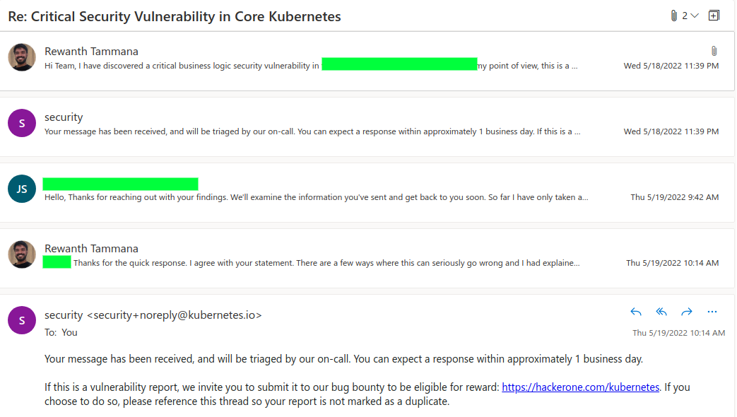
KUBERNETES SECURITY UPDATE 😶‍🌫️

Slide 17

RECENT PRESENTATION UPDATE 🤯
𝗖𝗼𝗺𝗽𝗿𝗼𝗺𝗶𝘀𝗶𝗻𝗴 𝗢𝗿𝗴𝗮𝗻𝗶𝘇𝗮𝘁𝗶𝗼𝗻𝗮𝗹 𝗦𝘆𝘀𝘁𝗲𝗺𝘀 𝘁𝗵𝗿𝗼𝘂𝗴𝗵 𝗖𝗵𝗮𝗶𝗻𝗶𝗻𝗴 𝗔𝘁𝘁𝗮𝗰𝗸𝘀
𝗢𝘂𝘁𝗹𝗶𝗻𝗲 𝗼𝗳 𝘁𝗵𝗲 𝗽𝗿𝗲𝘀𝗲𝗻𝘁𝗮𝘁𝗶𝗼𝗻:
1. Reconnaissance to SQL Injection.
2. SQL injection to Remote Code Execution (RCE).
3. Bypassing up-to-date Anti-Virus (AV) to gain persistent
access.
4. Remote Code Execution to Internal Systems Compromise
(includes backup server).
5. Internal Systems Compromise to support Gmail 2FA bypass.

Slide 18
UPCOMING RELEASES 🤫
There are a few projects I’m working on & will make them open-source in the next few weeks.
Gitleaks for enterprises - Python - HLD available
Escape Github Actions - Golang - My personal favorite - HLD available
Boiler template
Integrating Gitleaks with Escape Github Actions
Gatekeeper Helm Library - Rego
I can show the design(s) & overview of projects of your choice from above, if you are interested.

Slide 19

THANK YOU FOR STAYING SO FAR🙏
CONTACT
Google: Rewanth Tammana
Portfolio: rewanthtammana.com
Blog: blog.rewanthtammana.com
Github: rewanthtammana
Twitter: @rewanthtammana
LinkedIn: in/rewanthtammana

